Slide 1
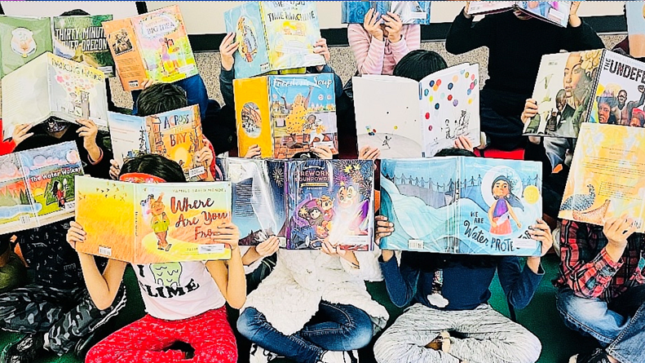
Mirrors Matter: How Inclusive Libraries Affirm and Inspire Students
April 20, 2023 BSF Luncheon
Presented by: BSD Teaching & Learning
Amber Anderson, Elementary Curriculum Developer
Eric Nelson, Elementary Curriculum Developer

Slide 2
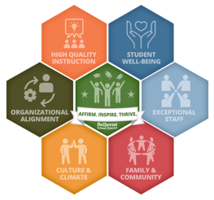
The Why
MISSION
To serve each and every student academically, socially, and emotionally, through a rigorous and relevant education that is innovative and individualized. As a learning community that values one another’s humanity, we provide courageous support for an equitable and exceptional education for all students.
VISION
To affirm and inspire each and every student to learn and thrive as creators of their future world.
Notes:
This exemplifies our BSD Vision, to affirm and inspire each and every student to learn and thrive as creates of their future world; a world with empathy and altruism.

Slide 3
Power of Culturally Responsive Texts
Validate & Affirm - Facilitate students seeing themselves and elevate identity.
Empower – Provide the cultural contexts for students to thrive!
Build - Facilitate students learning about people and cultures other than themselves.
Bridge - Intentional work to help students develop positive identity and dismantle stereotypes.
Notes:
To validate and affirm means to legitimize and value the peoples, culture and knowledge that is typically delegitimized and marginalized my mainstream sources of knowledge.
To empower – to situate our students in contexts in which they will thrive and feel comfortable to take risks academically, make connections and grow.
To build is add to our students’ cultural bank of knowledge, so they have the skills to navigate a culturally complex world, form healthy relationship and actively contribute to community.
To bridge is to guide students in developing cultural, linguistic and racial cognizance to strengthen our communities.

Slide 4
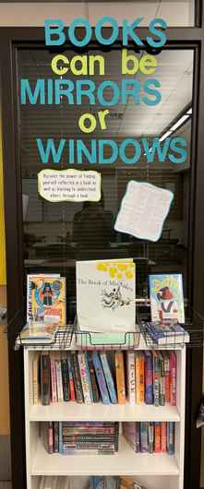
What is the hiSTORY of this Grant?
2017-18: Initiated following Literacy Team study in observations of classroom literacy and libraries. Desire to provide rich, inclusive text to affirm student identities and early literacy
2018-19: BSF Grant supported Culturally Responsive Classroom Libraries (CRCL) in all Title I Kindergarten Classrooms. BSD started professional learning centered on culturally responsive text selection and identity affirmation.
2019-20: BSF Grant supported all Kindergarten and 1st Grade Title I schools receiving CRCL. BSD supported Professional learning focused on cultivating shifts in literacy practice of text selection, identity affirmation, library organization and narrative elevation.
2020-21: BSF Grant supported all Title I Grade 2-5 and all Learning Assistance Program (LAP) Grades 1-5 with CRCL. BSD supported professional learning on culturally responsive and sustaining practices.
2021-22: BSF Grant supports all non-Title I and LAP schools receiving culturally responsive classroom libraries. BSD supported professional learning on culturally responsive and sustaining practices.
2022-23: BSF Grant supporting all K-5 classrooms to receive 8-12 books to add to all libraries (approximately 343 classes) and $1500 for each of our 11 Secondary School Libraries.

Slide 5
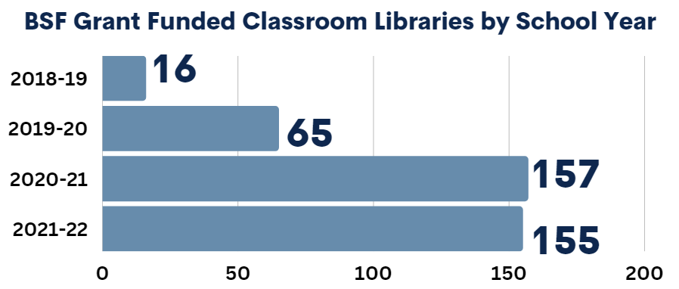
2018-22 Collective Impact
Each Classroom Library has 110-120 books elevating and affirming the diverse narratives in our BSD communities and not historically found in stores in bookshelves. This is approximately $1250-1450 per K-5 Classroom!
Notes:
Intended Impact – The power of the grant is to provide culturally responsive libraries to all Title I, second through fifth grade and Learning Assistance Program (LAP) funded elementary schools, first through fifth grade. We are thrilled to report that this will be our actual impact as well!
Actual Impact – We will be purchasing Culturally Responsive Libraries for all in person (hybrid) classrooms. We will focus on highlighting and increasing our digital content for our virtual classrooms.
Challenges – A unique challenge our virtual learning setting has provided is an opportunity to develop our digital collection. With this grant, we have purchased nearly 150 digital titles thus far and will be purchasing additional as we head into second semester! Publishers are releasing additional content that we are looking forward to providing for our students. Additionally, we are looking into purchasing additional audiobooks to support universal access and engagement for all students.
Rewards – We are expanding our collection in ways we never imagined! With digital books, all students can access, and we have therefore expanded what is possible for students to access from a classroom library. Additionally, we are developing an audiobook collection. This provides another modality for students, as well as supports Universal Design for Learning (UDL) and promotes access for all.

Slide 6
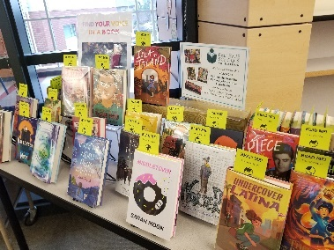
2022-23 Collective Impact
All 343, K-5 classrooms received a supplemental addition of 7-12 books to add to existing collections.
All 11 secondary libraries received inclusive library sets of 110-125 books ($1500).
Notes:
Intended Impact – The power of the grant is to provide culturally responsive libraries to all Title I, second through fifth grade and Learning Assistance Program (LAP) funded elementary schools, first through fifth grade. We are thrilled to report that this will be our actual impact as well!
Actual Impact – We will be purchasing Culturally Responsive Libraries for all in person (hybrid) classrooms. We will focus on highlighting and increasing our digital content for our virtual classrooms.
Challenges – A unique challenge our virtual learning setting has provided is an opportunity to develop our digital collection. With this grant, we have purchased nearly 150 digital titles thus far and will be purchasing additional as we head into second semester! Publishers are releasing additional content that we are looking forward to providing for our students. Additionally, we are looking into purchasing additional audiobooks to support universal access and engagement for all students.
Rewards – We are expanding our collection in ways we never imagined! With digital books, all students can access, and we have therefore expanded what is possible for students to access from a classroom library. Additionally, we are developing an audiobook collection. This provides another modality for students, as well as supports Universal Design for Learning (UDL) and promotes access for all.

Slide 7
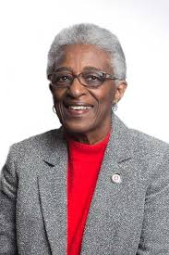
Windows & Mirrors
Dr. Rudine Sims-Bishop
Professor Emerita at Ohio State
Mirrors, Windows and Sliding Glass Doors
Source: We Need Diverse Books Campaign
Notes:
Video: https://www.youtube.com/watch?v=mrrh0G-OkBw&t=6s
Clip: 0:00 to 2:09
Professor Emerita at Ohio State University - https://en.wikipedia.org/wiki/Rudine_Sims_Bishop
Has been referred to as the “mother” of multicultural children’s literature
1982 Published a book Shadow and Substance – established a framework for analyzing children’s literature.
In her groundbreaking article, Mirrors, Windows and Sliding Glass Doors, she compels educators to see literature as an opportunity to not only see oneself and others, but to have empathy and understanding for others. This demands action by educators to intentionally provide
We are going to preview a short video from The We Need Diverse Books campaign, featuring author Matt de La Pena. He explains the Windows and Mirrors metaphor.

Slide 8
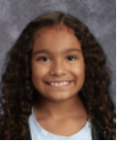
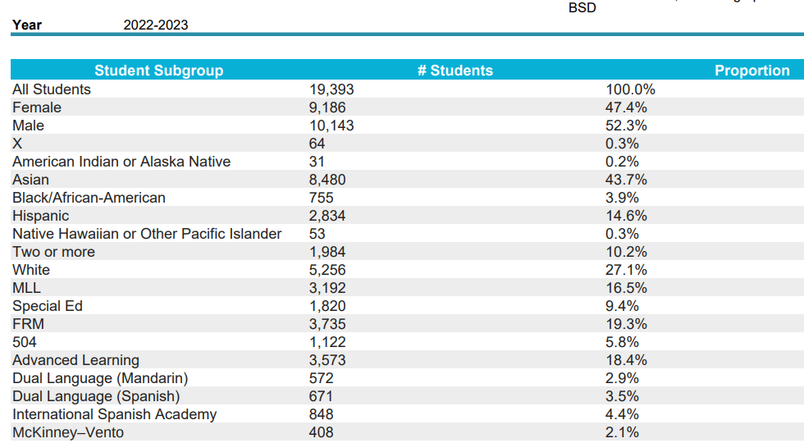
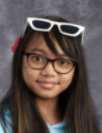
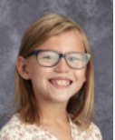
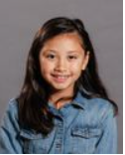
Serving Students

Slide 9
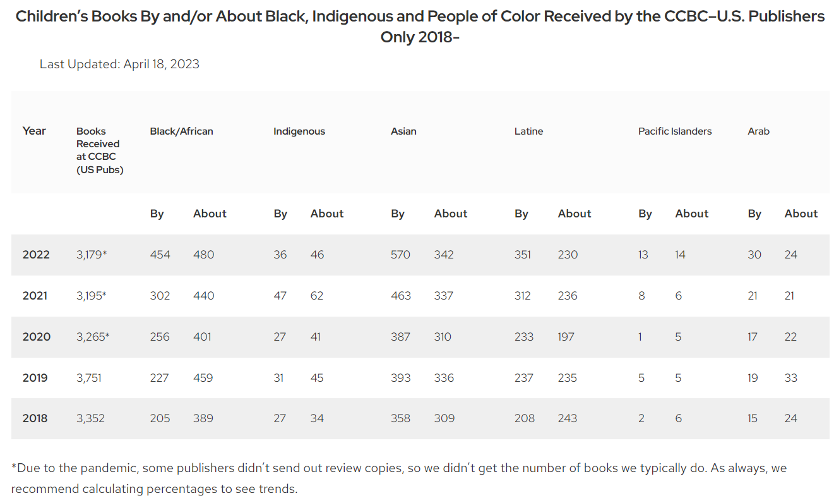
Publication Rates & Intentionality
Source: Cooperative Children’s Book Center School of Education
Notes:
According to the Cooperative Children’s Book Center (CCBC) 2019 annual review,^{[3]} “the number of books featuring BIPOC (Black, Indigenous, People of Color) protagonists lags far behind the number of books with White main characters—or even those with animals or other characters.
Taken together, books about White children, talking bears, trucks, monsters, potatoes, etc. represent nearly three quarters (71 percent) of children’s and young adult books published in 2019.” This means that overall, the books available for use in classroom libraries and lessons are pretty homogenous, when it comes to race and ethnicity. The children’s publishing industry also continues to reckon with its White-centeredness, especially in staff.
We also need to acknowledge the reality of US public education, which has generally been oriented toward White mainstream communities and, in fact, resisted full participation by others for hundreds of years.^{[4]} Through their purchase of children’s books, these same schools influence publishers’ decisions about what to bring to market.
Source: https://www.collaborativeclassroom.org/blog/inclusive-authentic-childrens-literature-in-the-classroom-ten-best-practices/

Slide 10
Kristy Hollis – Lake Hills ITCL
Notes:
YouTube: https://youtu.be/kWIGO1ndhJk
https://web.microsoftstream.com/video/464f5a6d-9e43-49d3-926c-d8be525b4e99

Slide 11
Professional Development
Cultivating Global Awareness and Cultural Competency through Literacy
The Affirmation Power of Literacy Experiences
Critical Consideration for Books with Authentic Voices
Culturally Responsive and Culturally Sustaining Literacy Practices

Slide 12
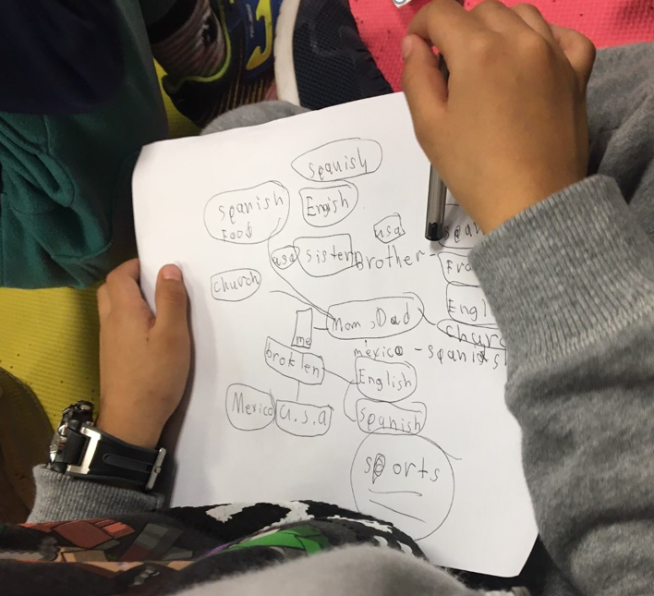
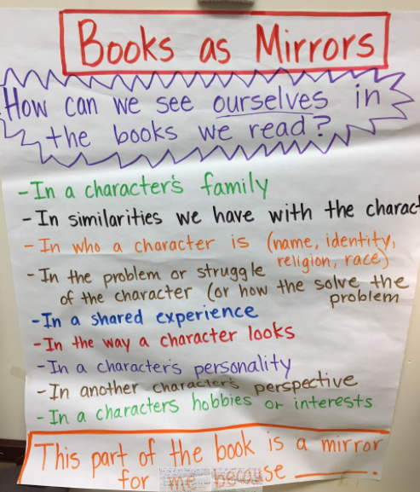
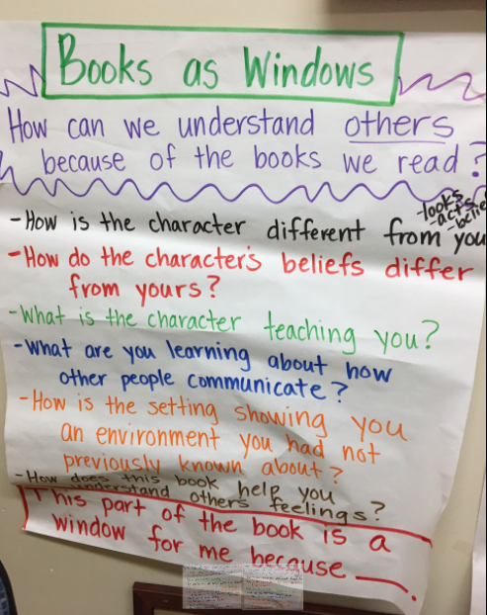
BSF Culturally Responsive & Sustaining Instructional Practices
Windows & Mirrors – Self Reflection
Windows & Mirrors – Seeing Beyond Self
Windows & Mirrors – Surveying & Noticing
Identity Mapping
Who’s Telling it?
Ways of Know: Book-Head-Heart
Cultivating Blindspot Awareness

Slide 13
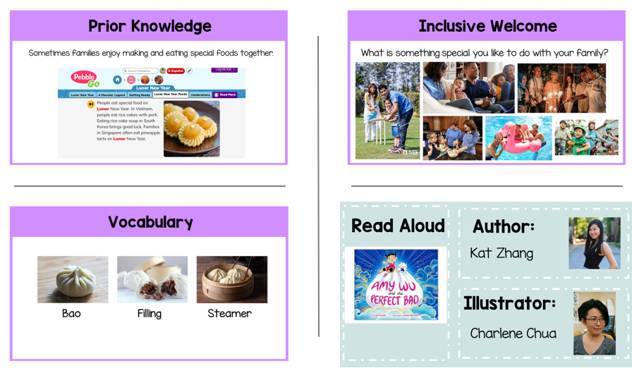
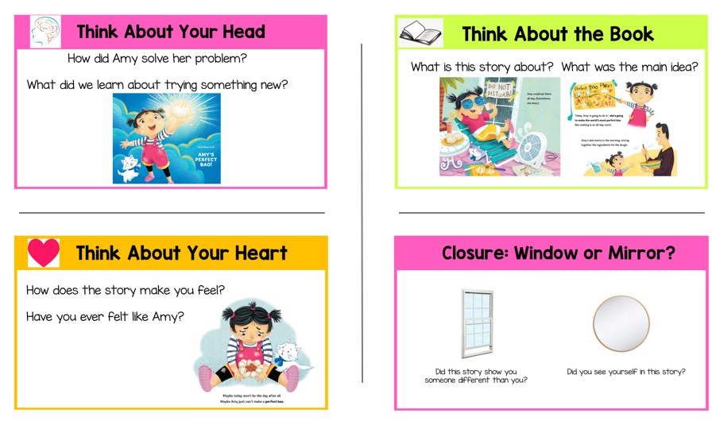
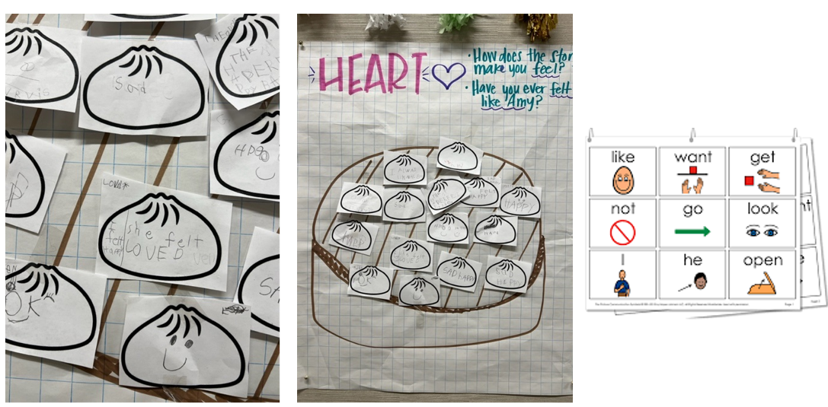
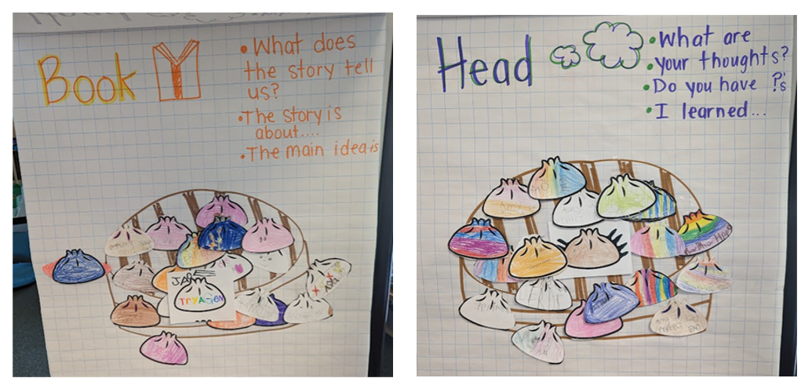
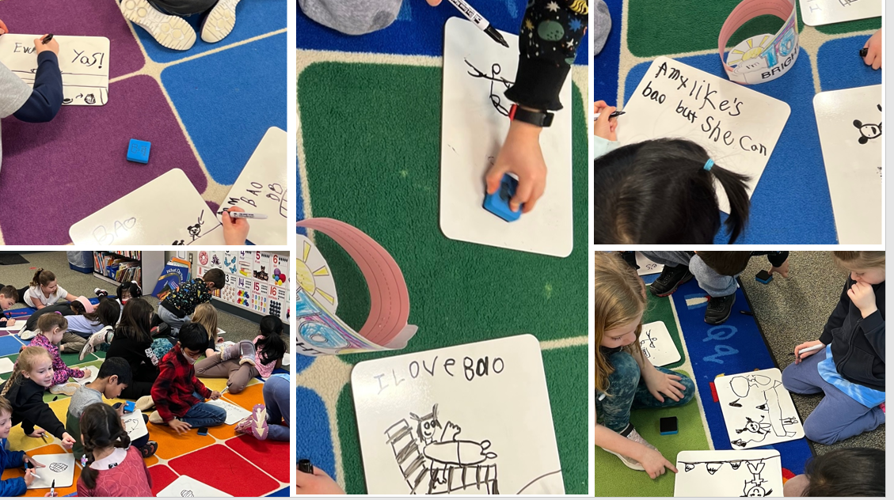
Bennett PD Samples - Kindergarten

Slide 14
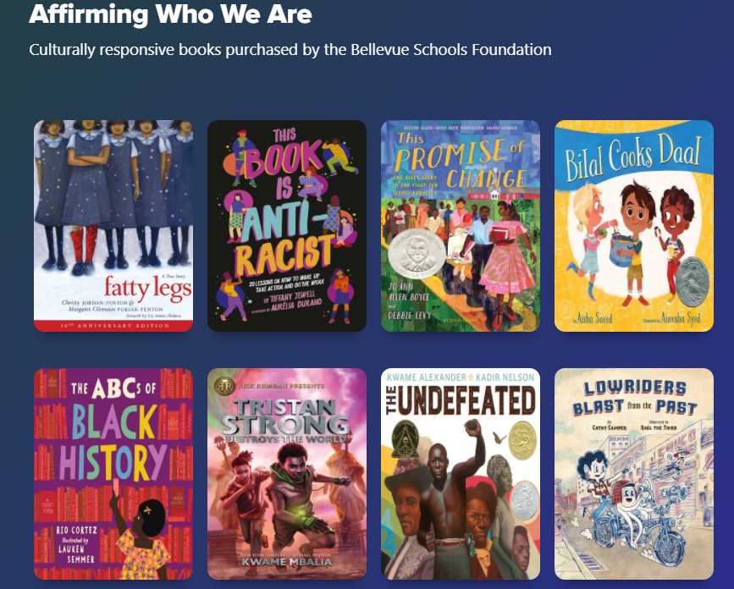
Digital Library
Currently 363 Titles – 323 ebooks & 40 audiobooks
25,000+ Check-outs since October – 10 times the amount a year ago
Most titles in the top 150 have been continuously checked out.
Many titles from the grant are in the top 10 check outs of all BSD digital books!
Title | # of Check-outs in Last 365 Days
Inside Our and Back Again | 180
One Crazy Summer | 171
Front Desk | 85
El Deafo | 81
When Stars are Scattered | 77
Notes:
Our digital titles are a hit! We created a special collection of the books brought to students by BSF (363 digital books).
Overall, we have had 25,000+ check outs of the 363 books. Seven of the ten top titles are licensed for Simultaneous Use, allowing as many kids can check it out as want it at the same time. The other titles in the top ten we own multiple copies of.
Most of the other titles in the top 150 have almost been checked out continuously, all year as we own only 1 copy; the checkout period is two weeks.

Slide 15
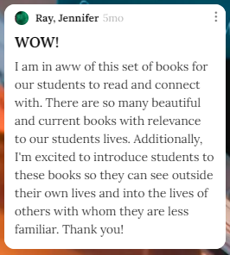
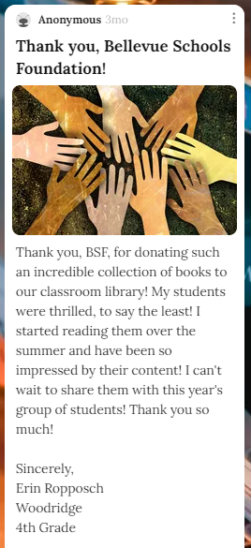
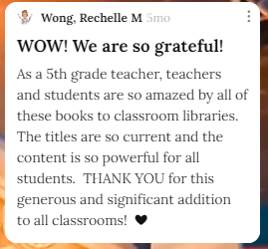
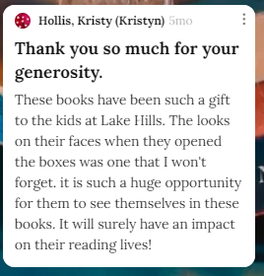
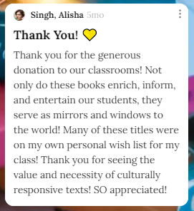
Educator Padlet
https://padlet.com/andersonam4/ohagqmep84gce9tu
Notes:
Padlet: https://padlet.com/andersonam4/ohagqmep84gce9tu

Slide 16
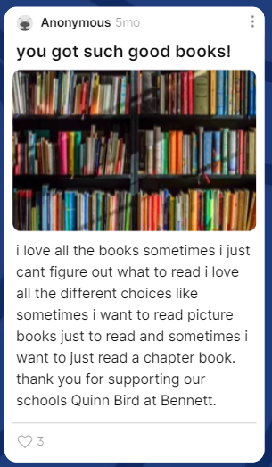
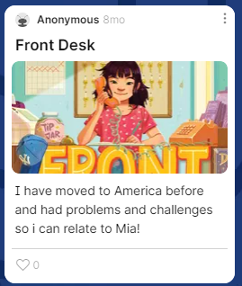
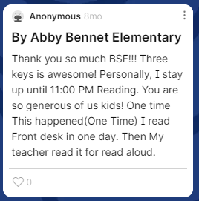
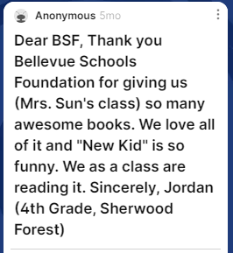
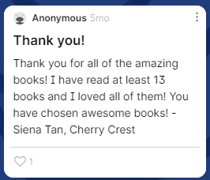
Student Padlet
https://padlet.com/andersonam4/miumek6loxzhjg39
Notes:
https://padlet.com/andersonam4/miumek6loxzhjg39

Slide 17
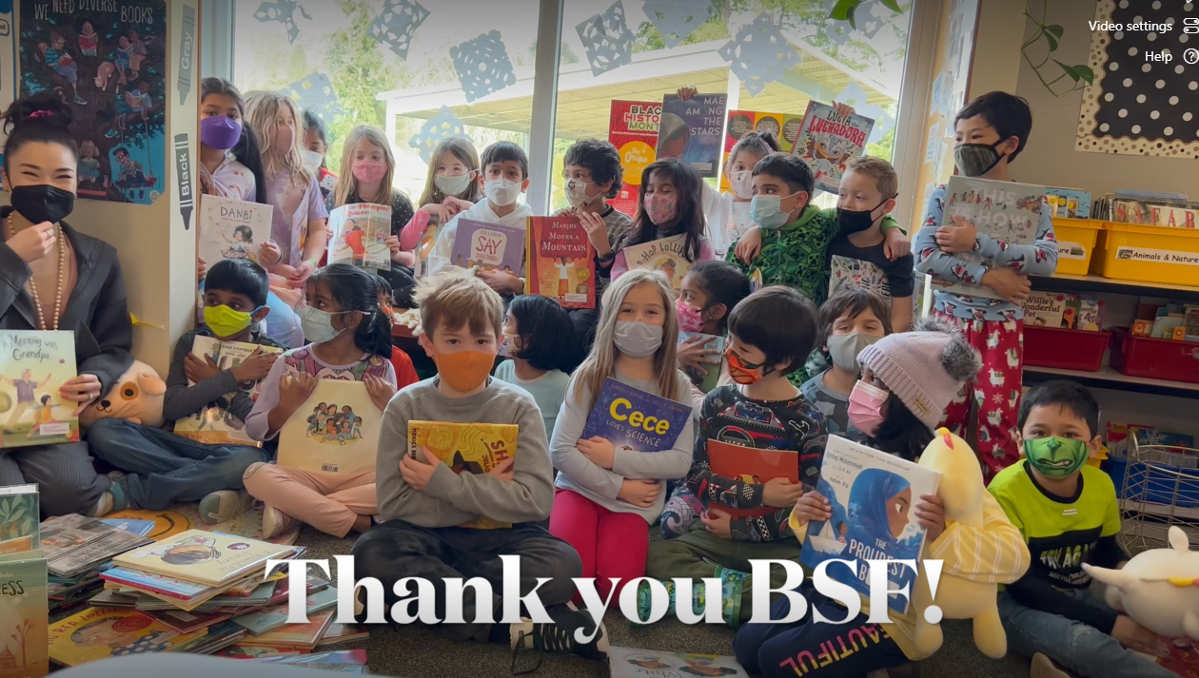
Gratitude
Immense Gratitude for the partnership and extensive support
Supporting the inclusion of digital texts!
Excited about Next Steps!
Notes:
If there is time…..
Thank you for Ms. Surdi's Class
Full Address:
https://bsd405.sharepoint.com/sites/curriculum/Literacy/Shared%20Documents/Forms/AllItems.aspx?viewpath=%2Fsites%2Fcurriculum%2FLiteracy%2FShared%20Documents%2FForms%2FAllItems%2Easpx&id=%2Fsites%2Fcurriculum%2FLiteracy%2FShared%20Documents%2FCRCL%20Thank%20Yous%21%2FIMG%5F0744%2EMOV&viewid=9c888ddd%2Dfd61%2D4732%2D90ba%2Dade8404c6a76&parent=%2Fsites%2Fcurriculum%2FLiteracy%2FShared%20Documents%2FCRCL%20Thank%20Yous%21

Slide 18
Questions

